Slide 1
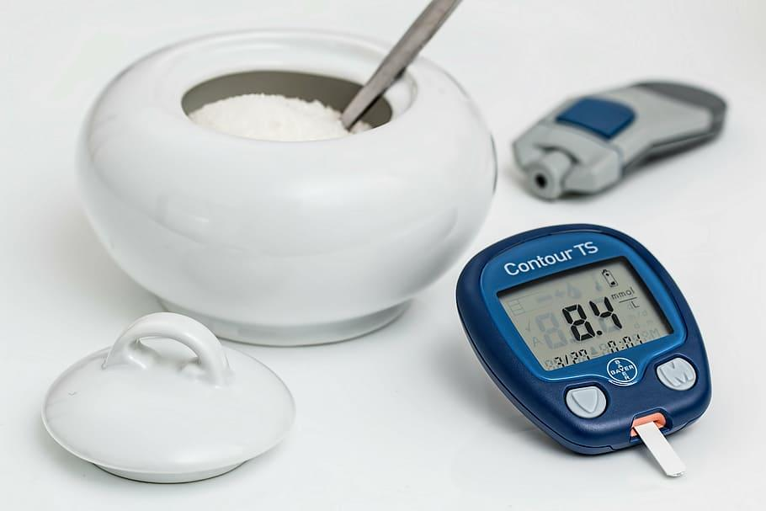
Diabetes
Prediction
ML
Project
Submitted by:
ISHAN AGRAWAL

Slide 2
CONTENTS
Introduction
Problem Statement
Solution
Data information
Data Manipulation
Model development and training
Accuracy metrics
Web interface
Future plans
Jupyter Notebook Project

Slide 3
INTRODUCTION
2021: 537 million adults (20–79 years) have diabetes, which is 1 in 10 people.
2045: The number of people living with diabetes is projected to rise to 643 million, and 783 million by 2045
Diabetes is a major cause of blindness, kidney failure, heart attacks, stroke, and lower limb amputation.
High blood sugar levels can damage blood vessels, leading to these serious complications over time. Managing diabetes through medication, diet, and lifestyle changes can significantly reduce the risk of these complications.

Slide 4
PROBLEM STATEMENT
We need to develop a machine learning model to predict the likelihood of a person having diabetes based on certain health metrics and demographic information. The model should take into account features such as age, BMI, blood pressure, and other relevant factors to make accurate predictions. The goal is to provide healthcare providers with a tool that can assist in early identification and management of diabetes.

Slide 5
SOLUTION
We can have historical data of patients. If this condition is met, then we can apply SUPERVISED Machine Learning models.
Main point to be noted is either the patient will be having diabetes or not. So we can classify into 2 classes. Hence, it is a BINARY CLASSIFICATION problem.
Some of the models that we can use are:
Logistic Regression
Deep Neural Network classification
Support Vector Machines Classification
Decision Trees etc.

Slide 6
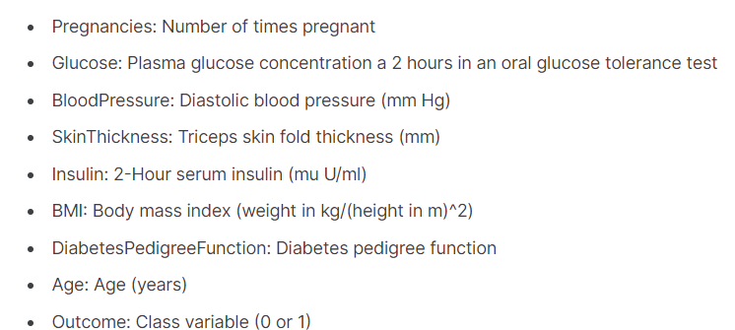
DATA INFORMATION
We have CSV file containing 768 rows of data corresponding to 768 patients. Total number of features are 8. 1 target label column is present(0-no diabetes, 1-diabetic patient).

Slide 7
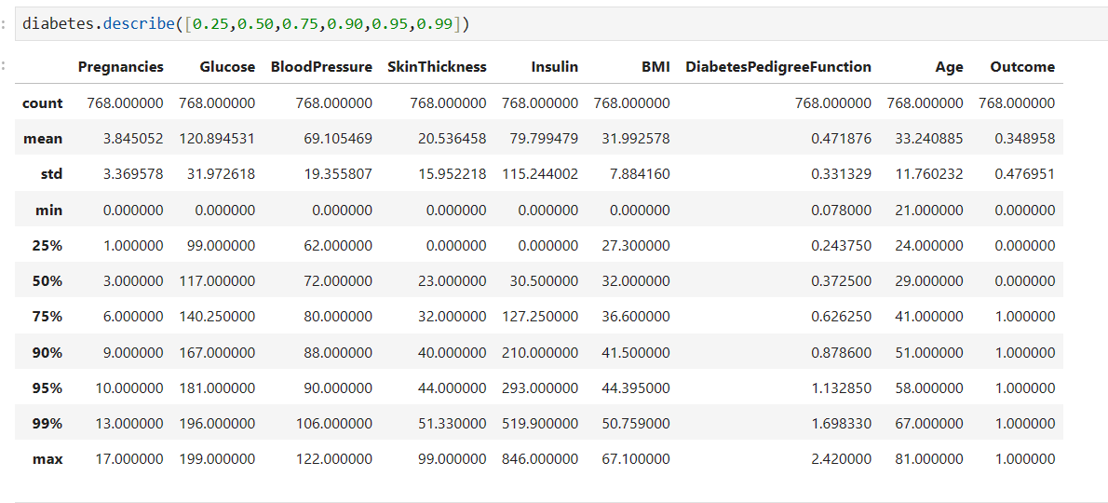
DATA MANIPULATION
No null values
Found some distorted distribution of 3 variables(will see in video).
Applied clipping in 3 columns.
After splitting, MinMax Scaling used.

Slide 8
MODEL DEVELOPMENT, TRAINING
AND EVALUATION
Using Support Vector Machines Classifier here
Imported SVC from sklearn.SVM
Imported accuracy_score from sklearn.metrics
Trained SVC model with Linear Kernel
Found Accuracy score on Training dataset
Found Accuracy score on Testing dataset

Slide 9
WEB INTERFACE
Make HTML/CSS website form
Add appropriate tags
Create FLASK app
Create API routing to EXTRACT INPUT DATA from form
Run ML model code
Return result to end-user
Note: I don't know how to make web interface but will learn and will complete this project.

Slide 10
FUTURE PLANS
Current accuracy on training dataset: 77% approx
Current accuracy on testing dataset: 75% approx.
In future, will train SVC model with different kernels and will look for better accuracy.
Will make Neural Network classification models, different kernel in SVM
Will make interface and use best models for prediction
Provide model to professionals to use and prevent onset of diabetes.

Slide 11
Thank You

